Slide 1
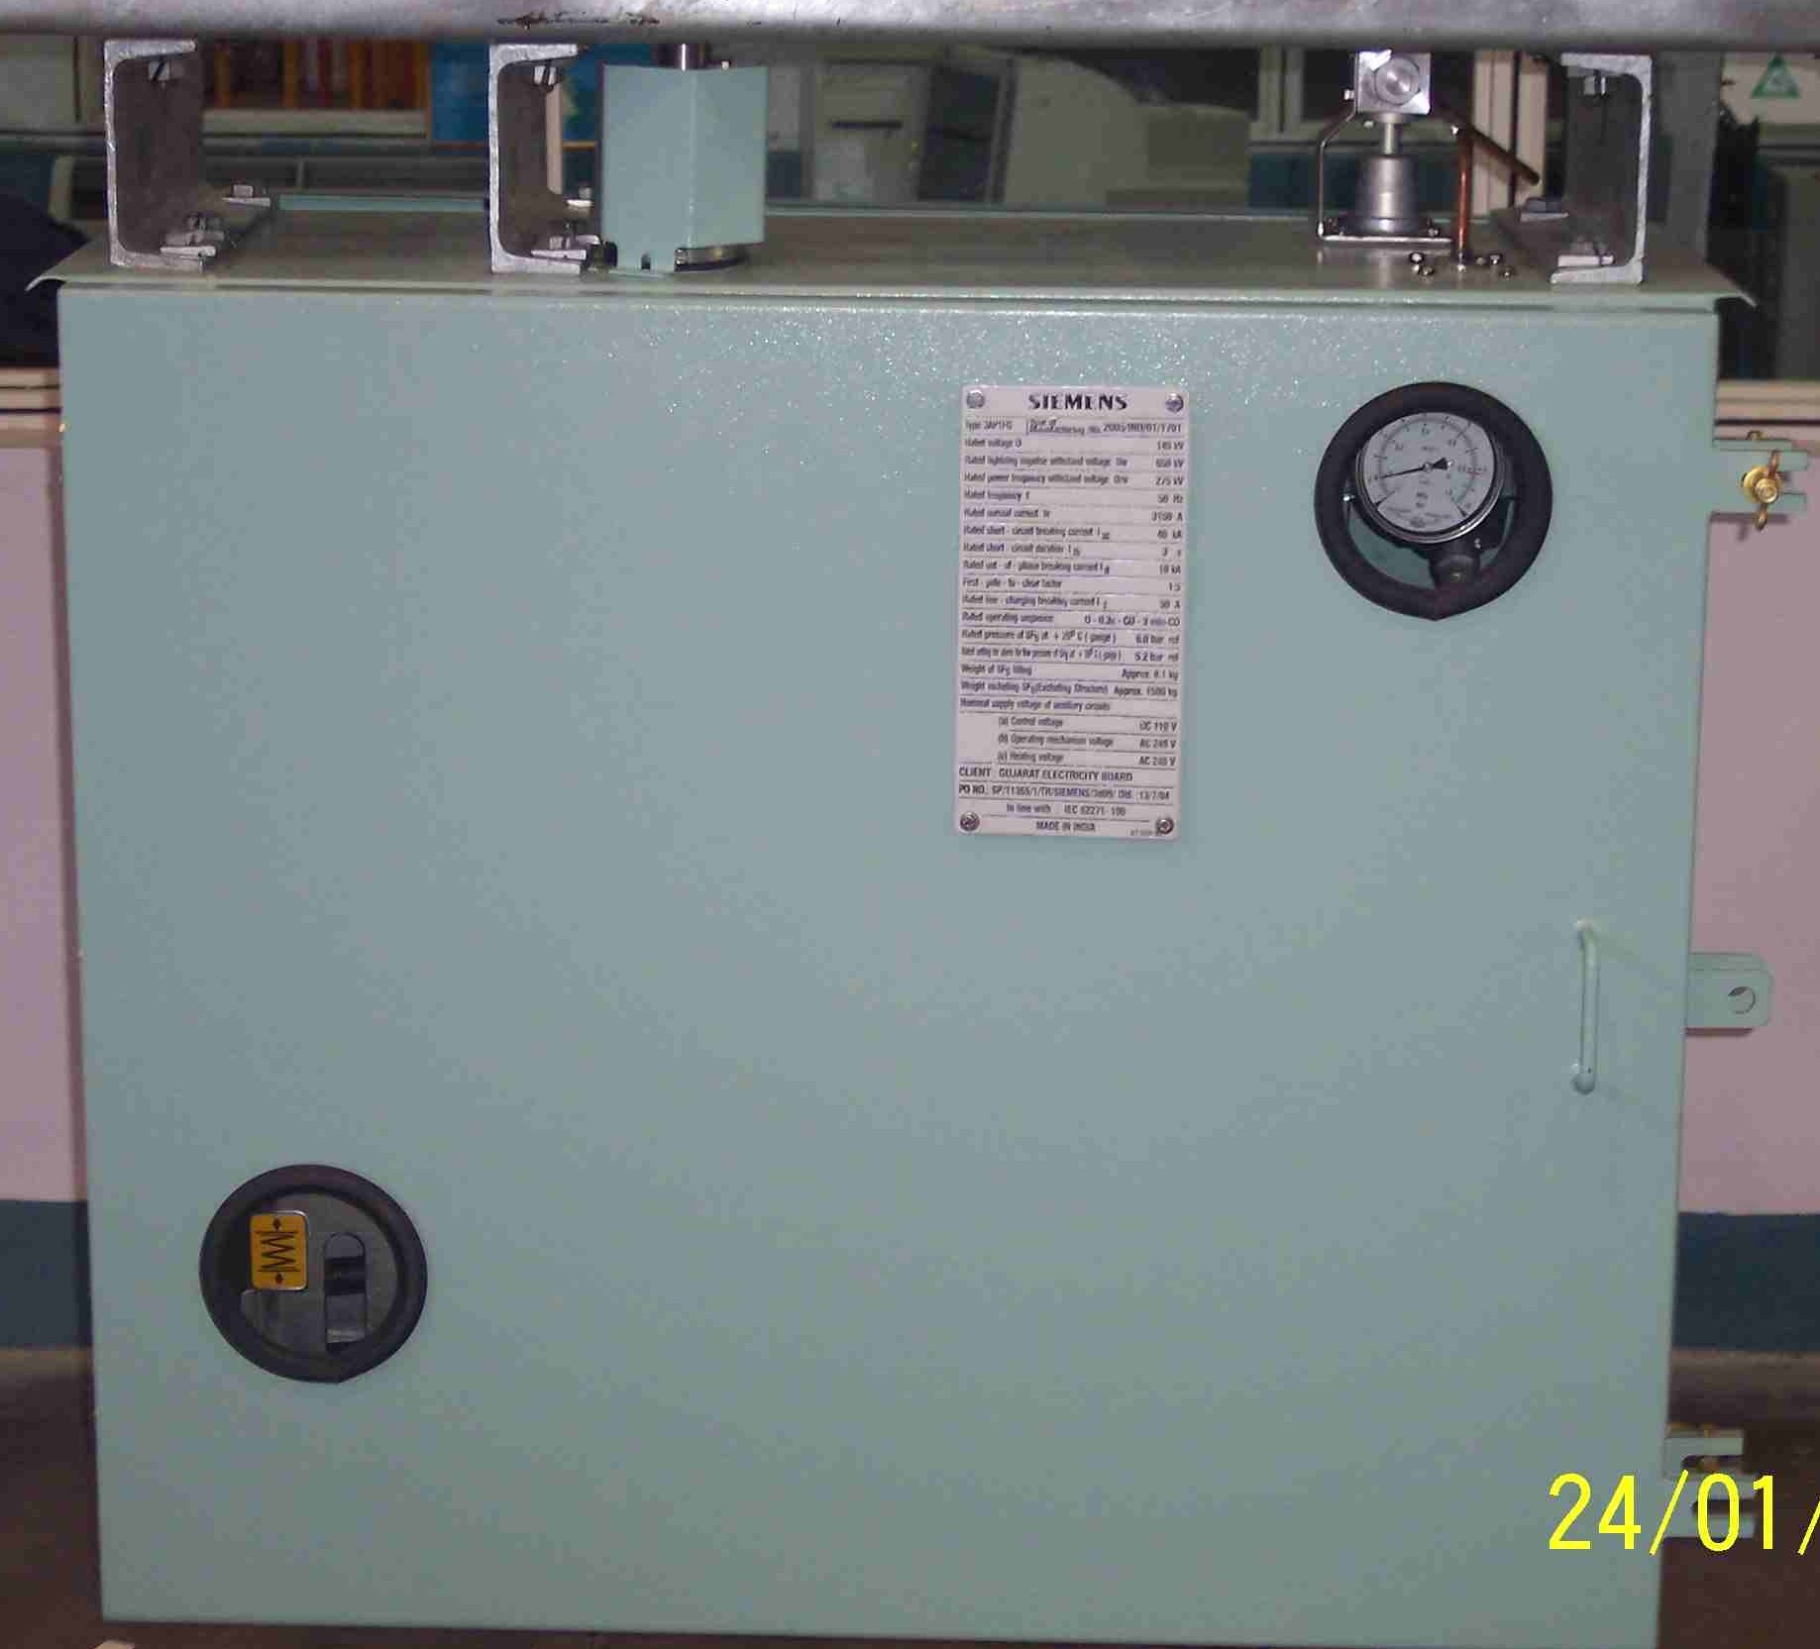
SIEMENS
HVCB SPARES
Drive Mechanism with Panel
72.5KV, 40KA & 145KV CB
S4711041012

